Slide 1
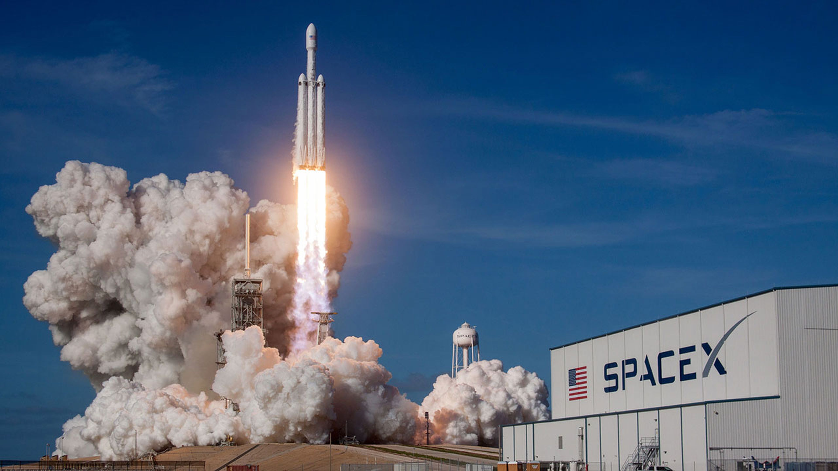
Data Science Capstone Project
Hugo Sánchez Ttito
21.01.2024

Slide 2
Outline
Executive Summary
Introduction
Methodology
Results
Conclusion
Appendix

Slide 3
Executive Summary
Summary of methodologies
Data collection (Data Collection via API, Web Scraping)
Data wrangling
Exploratory Data Analysis with SQL
EXPLORATORY DATA ANALYSIS WITH DATA VISUALIZATION (Pandas and Matplotlib)
Building an interactive map with Folium
Building a Dashboard with Plotly Dash
Predictive analysis (Classification)
Summary of all results
Exploratory Data Analysis results
Interactive analytics demo in screenshots
Predictive analysis results

Slide 4
Introduction
Project background and context: This project aims to predict the successful landing of the Falcon 9 first stage, a critical aspect considering SpaceX's claim on their website that the cost of their Falcon 9 rocket launch is 62 million dollars, significantly lower than the costs of other providers, mainly because of SpaceX's ability to reuse the first stage. The prediction of the landing outcome is crucial not just for cost estimation but also for potential competitors seeking insights into SpaceX's cost-effective approach to rocket launches.
Problems seeking solutions
What characteristics distinguish a landing as successful or failed?
How do the relationships among various rocket variables influence the success or failure of a landing?
What conditions will enable SpaceX to achieve the highest landing success rate?

Slide 5
Methodology
Data collection methodology:
Using SpaceX Rest API
Using Web Scrapping from Wikipedia
Performed data wrangling
Filtering the data
Dealing with missing values
Using One Hot Encoding for classification models
Performed exploratory data analysis (EDA) using visualization and SQL
Performed interactive visual analytics using Folium and Plotly Dash
Performed predictive analysis using classification models
Building, tuning and evaluation of classification models

Slide 6
Methodology - Data collection
The data collection process utilized a dual approach, incorporating API requests from SpaceX REST API and employing web scraping techniques to extract information from a table within SpaceX's Wikipedia entry. This combined methodology was necessary to ensure comprehensive data gathering for a more thorough analysis of launches.
The data columns obtained through the SpaceX REST API include: FlightNumber, Date, BoosterVersion, PayloadMass, Orbit, LaunchSite, Outcome, Flights, GridFins, Reused, Legs, LandingPad, Block, ReusedCount, Serial, Longitude, and Latitude.
In contrast, the data columns acquired through Wikipedia web scraping encompass: Flight No., Launch site, Payload, PayloadMass, Orbit, Customer, Launch outcome, Version Booster, Booster landing, Date, and Time.
This dual-sourced data compilation ensures a comprehensive dataset for a detailed and comprehensive analytical examination.

Slide 7
Methodology - Data collection via API
Requesting information about rocket launches by accessing SpaceX's API.
Parsing the response content by utilizing the .json() function and converting it into a dataframe through the application of .json_normalize().
Requesting the required details regarding SpaceX launches by employing customized functions to interact with the SpaceX API.
Organizing the acquired data into a dictionary structure.
Generating a dataframe using the information stored in the dictionary.
Refining the dataframe to exclusively incorporate Falcon 9 launches.
Substituting the missing values in the Payload Mass column with the calculated mean for that specific column.
Saving the data to a CSV file.

Slide 8
Methodology - Data collection via Web scraping
Retrieving Falcon 9 launch information from Wikipedia
Initializing a BeautifulSoup object from the HTML response.
Extracting column names from the HTML table header.
Collecting data by parsing HTML tables.
Organizing the acquired data into a dictionary.
Creating a dataframe from the dictionary.
Exporting the data to a CSV file.

Slide 9
Methodology - Data wrangling
In the dataset, unsuccessful booster landings are categorized based on outcomes like True Ocean (successful ocean landing), False Ocean (unsuccessful ocean landing), True RTLS (successful ground pad landing), False RTLS (unsuccessful ground pad landing), True ASDS (successful drone ship landing), and False ASDS (unsuccessful drone ship landing). For simplicity, these outcomes are converted into Training Labels: "1" for successful landings and "0" for unsuccessful ones.
Determine the count of launches for each launch site.
Calculate the frequency and occurrence of each orbit in the dataset.
Calculate the number and occurrence of mission outcomes for each orbit type.
Generate a landing outcome label based on the information in the Outcome column.
Export the processed data to a CSV file.
Conduct exploratory data analysis to identify and define training labels.

Slide 10
Methodology – EDA with data visualization
Various charts were generated to visually represent different aspects of the dataset:
Flight Number vs. Payload Mass
Flight Number vs. Launch Site
Payload Mass vs. Launch Site
Orbit Type vs. Success Rate
Flight Number vs. Orbit Type
Payload Mass vs. Orbit Type
Yearly Trend of Success Rate
Scatter plots were utilized to illustrate the relationships between variables, offering insights that could be valuable in constructing machine learning models.
Bar charts were employed to compare discrete categories, emphasizing the relationships between specific categories and measured values.
Line charts were used to depict trends in data over time, particularly in the context of time series analysis.

Slide 11
Methodology - EDA with SQL
Displaying the unique launch site names in the space mission.
Displaying 5 records where launch sites initiate with the string 'CCA.'
Displaying the total payload mass carried by NASA (CRS) launched boosters.
Displaying the average payload mass carried by booster version F9 v1.1.
Listing the date of the initial successful ground pad landing outcome.
Listing the names of boosters with success in drone ship landings and payload mass between 4000 and 6000.
Listing the total number of successful and failure mission outcomes.
Listing the names of booster versions that carried the maximum payload mass.
Listing the failed drone ship landing outcomes, along with booster versions and launch site names, for the months in the year 2015.
Ranking the count of landing outcomes (e.g., Failure (drone ship) or Success (ground pad)) between the dates 2010-06-04 and 2017-03-20 in descending order.

Slide 12
Methodology - Build an Interactive Map with Folium
Markers for All Launch Sites:
Implemented markers with circles, popup labels, and text labels for NASA Johnson Space Center, utilizing its latitude and longitude coordinates as the starting location.
Introduced markers with circles, popup labels, and text labels for all launch sites, incorporating their latitude and longitude coordinates to illustrate their geographical positions and proximity to the Equator and coastlines.
Colored Markers for Launch Outcomes at Each Launch Site:
Integrated colored markers representing success (Green) and failure (Red) launches, utilizing a Marker Cluster to identify launch sites with relatively high success rates.
Distances from a Launch Site to Its Proximities:
Incorporated colored lines to depict distances between the launch site KSC LC-39A (as an example) and its surroundings, including railways, highways, coastlines, and the closest city.

Slide 13
Methodology - Dashboard with Plotly Dash
Dropdown Menu for Launch Sites:
Implemented a dropdown menu to facilitate the selection of launch sites.
Pie Chart Displaying Success Launches (All Sites/Specific Site):
Introduced a pie chart to visually represent the overall count of successful launches for all sites and the breakdown of success vs. failure counts if a particular launch site is chosen.
Payload Mass Range Slider:
Integrated a slider for selecting the payload mass range.
Scatter Chart depicting Payload Mass vs. Success Rate across Various Booster Versions:
Added a scatter chart to illustrate the relationship between payload mass and launch success for different booster versions.

Slide 14
Methodology - Predictive analysis (Classification)
Creating a NumPy array by extracting the "Class" column from the dataset.
Standardizing the data using StandardScaler, involving both fitting and transforming the data.
Dividing the dataset into training and testing sets through the use of the train_test_split function.
Establishing a GridSearchCV object with a cross-validation value of 10 to identify the optimal parameters.
Applying GridSearchCV on Logistic Regression, Support Vector Machine (SVM), Decision Tree, and K-Nearest Neighbors (KNN) models.
Calculating the accuracy on the test data for all models using the .score() method.
Analyzing the confusion matrix for each model.
Determining the best-performing method by evaluating Jaccard_score and F1_score metrics.

Slide 15
Results
Exploratory data analysis results
Interactive analytics demo in screenshots
Predictive analysis results

Slide 16
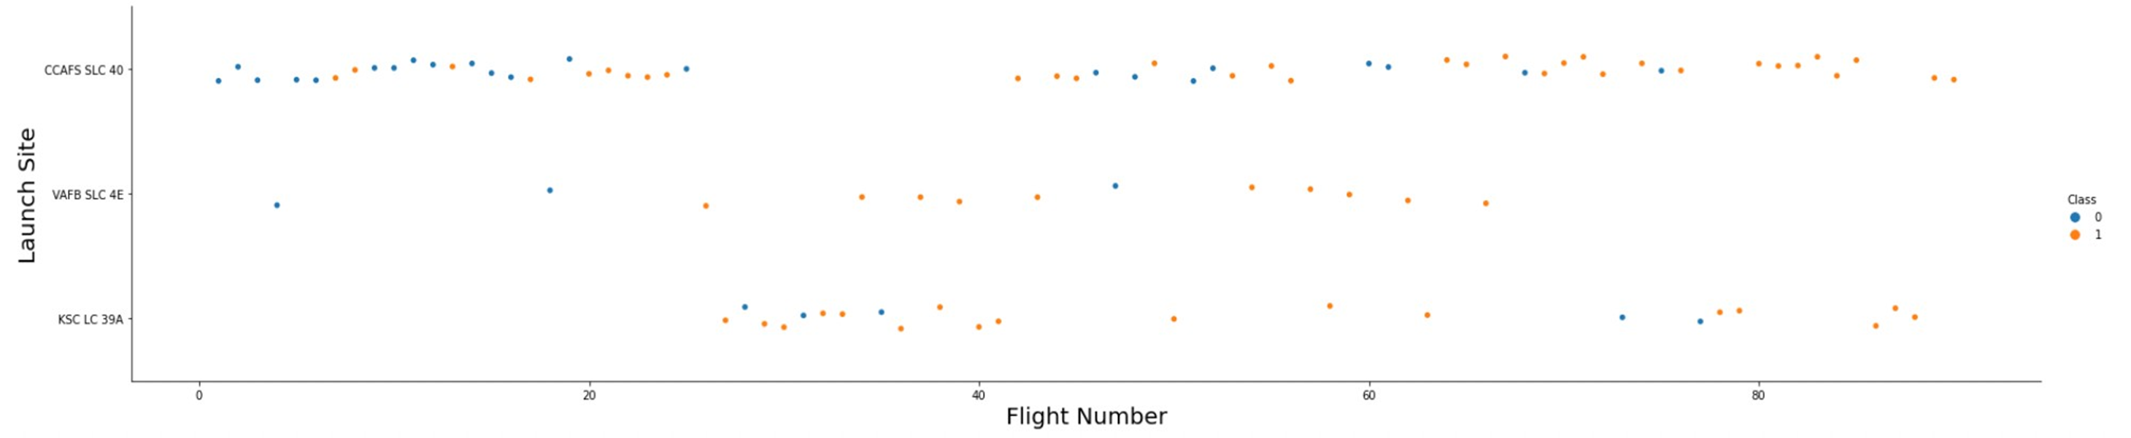
EDA with Visualization (Flight Number vs. Launch Site)
It is evident that, for each site, the success rate is on the rise.

Slide 17
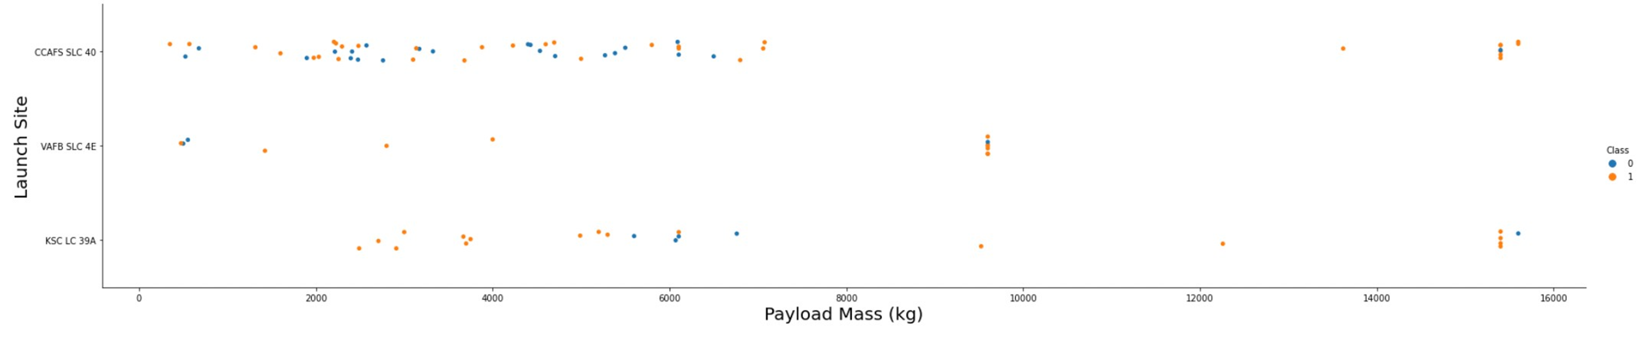
EDA with Visualization (Payload vs. Launch Site)
The success of a landing seems to be influenced by the launch site, with heavier payloads potentially playing a role in a successful outcome. However, it's important to note that an excessively heavy payload could contribute to a landing failure.

Slide 18
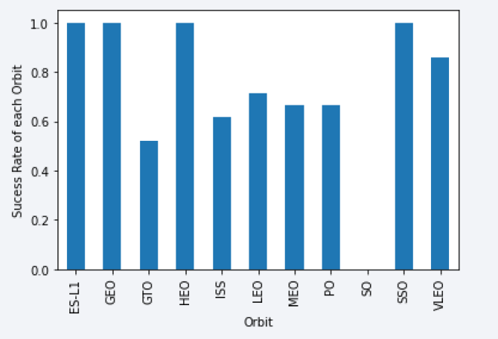
EDA with Visualization (Success Rate vs. Orbit Type)
This plot allows us to observe the success rates for different orbit types. Notably, ES L1, GEO, HEO, and SSO exhibit the highest success rates.

Slide 19
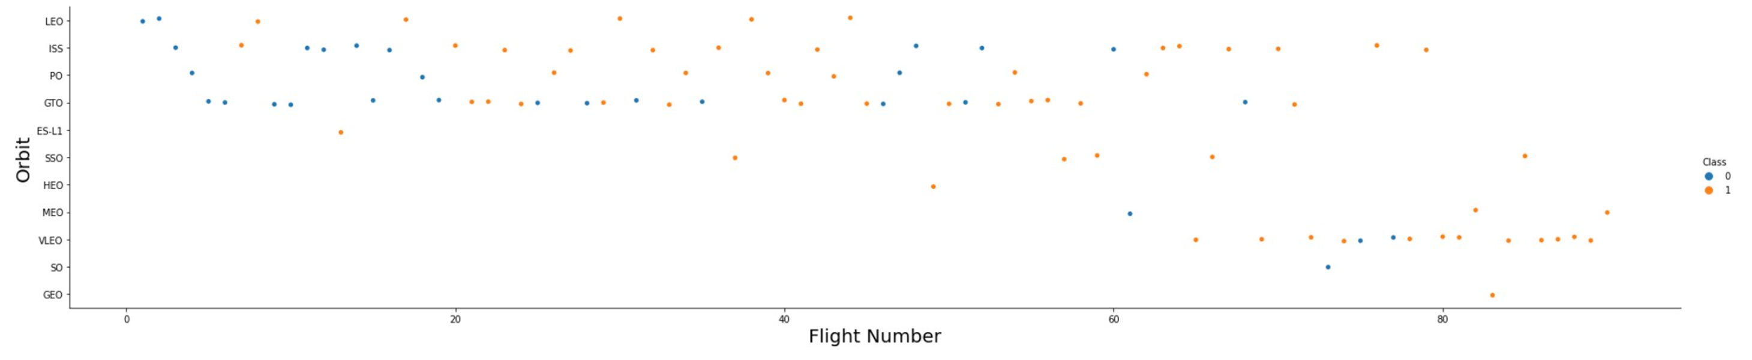
EDA with Visualization (Flight Number vs. Orbit Type)
The success rate tends to increase with the number of flights in the Low Earth Orbit (LEO). While no clear relationship is observed for Geostationary Transfer Orbit (GTO), the high success rates in orbits like Sun-Synchronous Orbit (SSO) or Highly Elliptical Orbit (HEO) may be influenced by knowledge gained from past launches in other orbits.

Slide 20
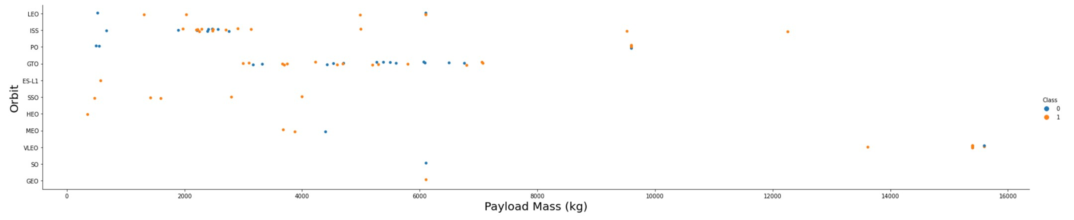
EDA with Visualization (Payload vs. Orbit Type)
The payload weight significantly affects the success rate of launches in specific orbits. For instance, in the Low Earth Orbit (LEO), heavier payloads contribute to an improved success rate. Conversely, in the Geostationary Transfer Orbit (GTO), reducing the payload weight appears to enhance the likelihood of a successful launch.

Slide 21
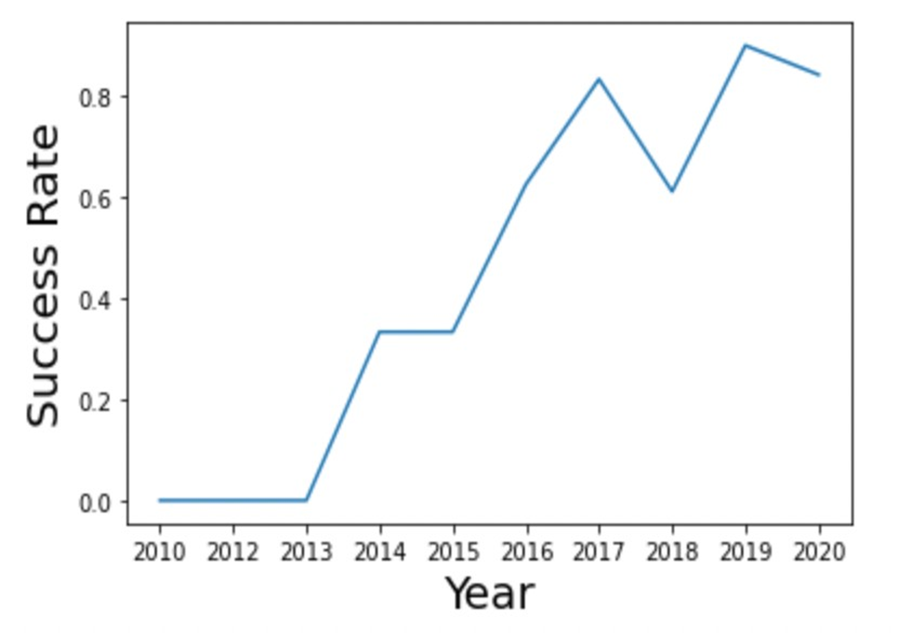
EDA with Visualization (Launch Success Yearly Trend)
FROM 2013 ONWARD, THERE IS A NOTICEABLE UPWARD TREND IN THE SUCCESS RATE OF SPACEX ROCKETS.

Slide 22
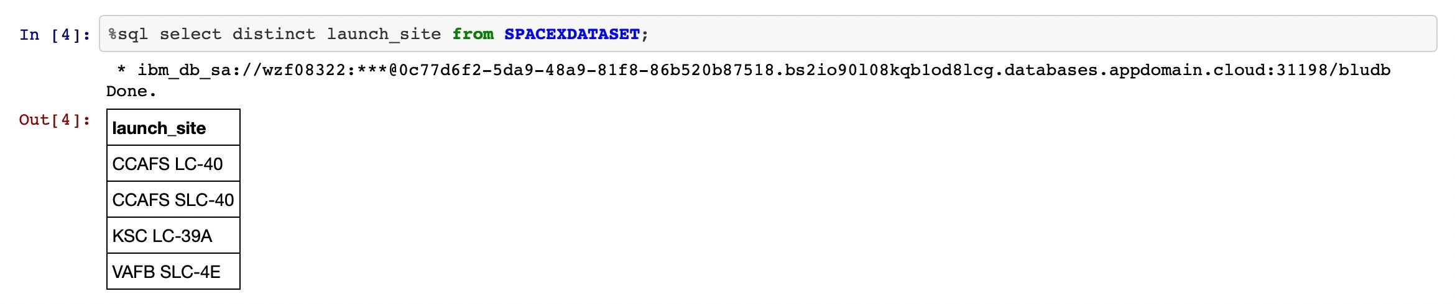
EDA with SQL (All launch site names)
Presenting the names of the distinct launch sites in the space mission.

Slide 23
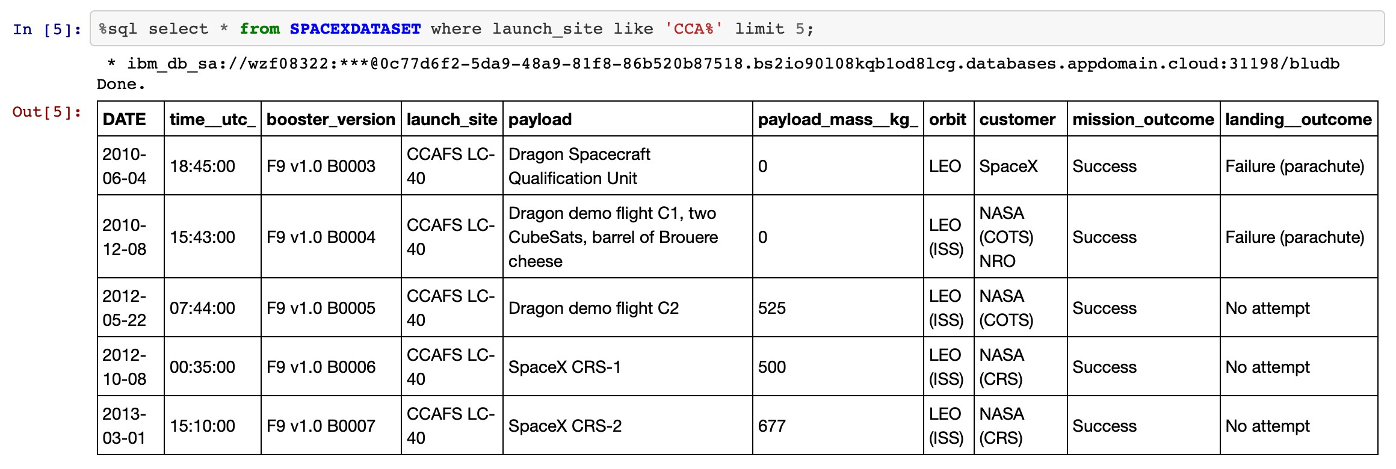
EDA with SQL (Launch site names begin with 'CCA')
Showcasing 5 records where launch sites commence with the string 'CCA.'

Slide 24
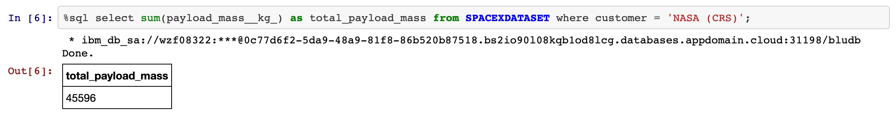
EDA with SQL (Total payload mass)
Presenting the total payload mass carried by boosters launched by NASA (CRS).

Slide 25
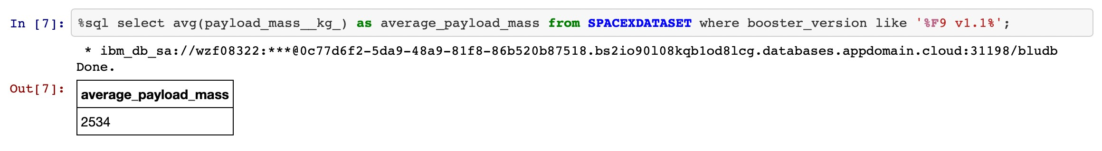
EDA with SQL (Average payload mass by F9 v1.1)
Illustrating the average payload mass carried by the booster version F9 v1.1.

Slide 26
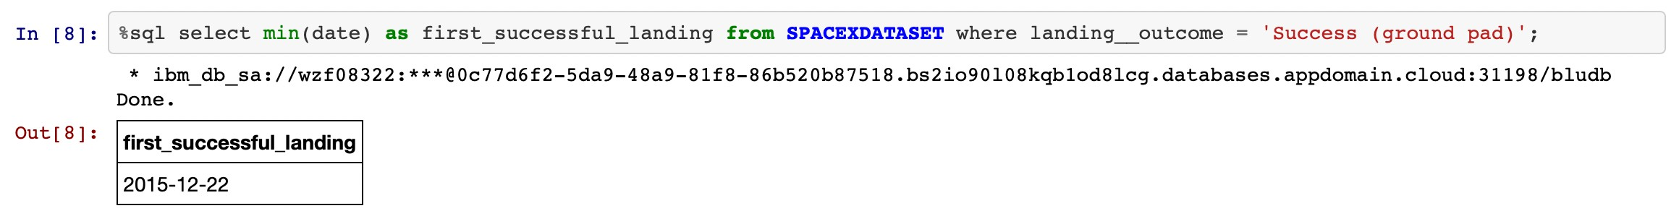
EDA with SQL (First successful ground landing date)
Enumerating the date of the initial successful landing outcome on the ground pad.

Slide 27
EDA with SQL (First successful ground landing date)
Providing the date of the first successful landing outcome on the ground pad.

Slide 28
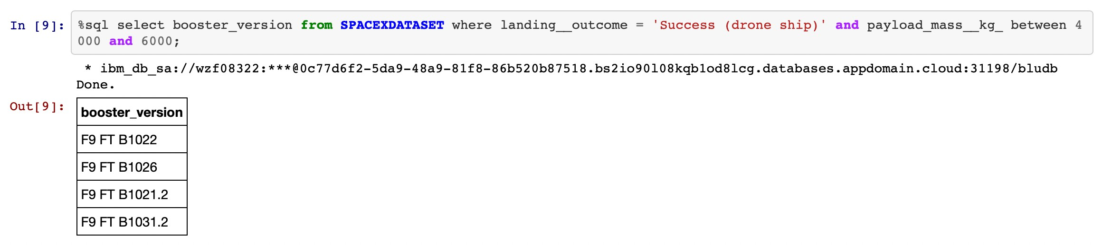
EDA with SQL (Successful drone ship landing with payload
between 4000 and 6000
Explanation:)
Enumerating the names of boosters that achieved success in drone ship landings and had a payload mass greater than 4000 but less than 6000.

Slide 29
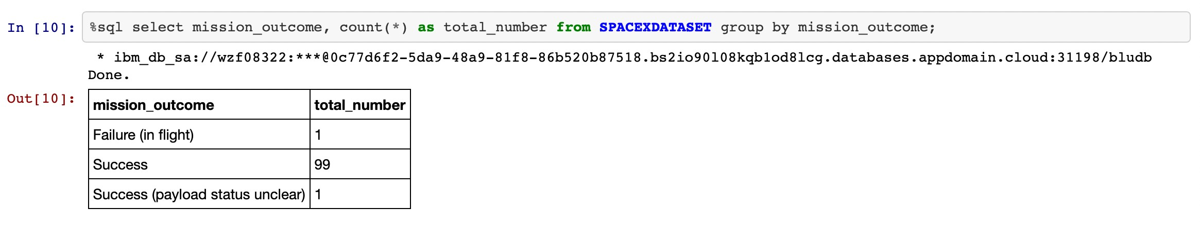
EDA with SQL (Total number of successful and failure
mission outcomes)
Tabulating the total number of successful and failed mission outcomes.

Slide 30
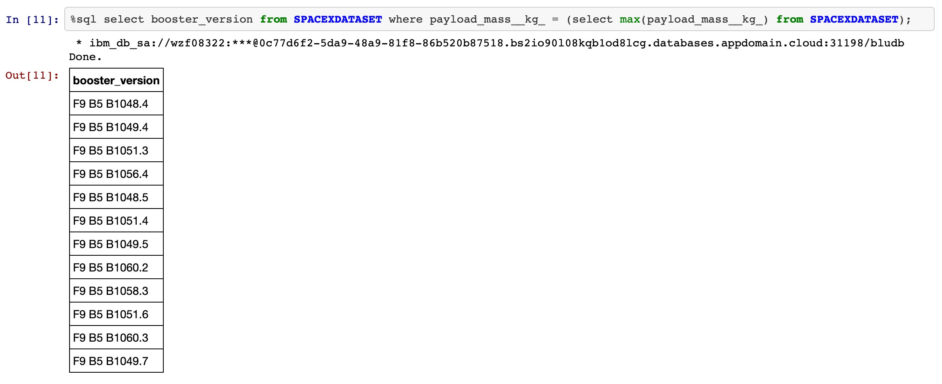
EDA with SQL (Boosters carried maximum payload)
Enumerating the names of booster versions that have carried the maximum payload mass.

Slide 31
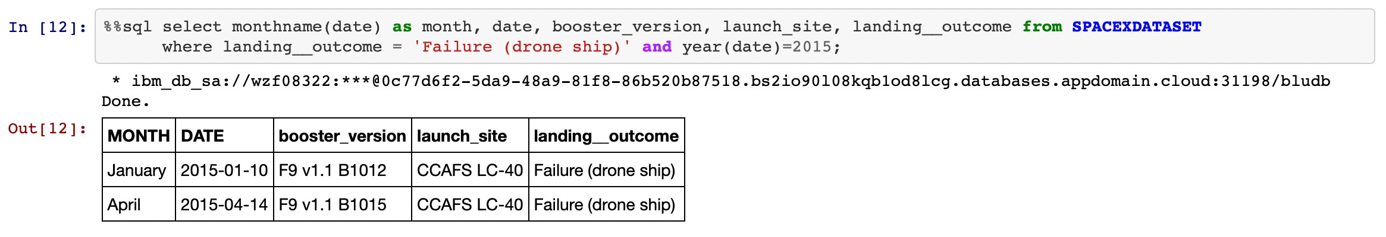
EDA with SQL (2015 launch records)
Providing a list of failed landing outcomes on the drone ship, along with their booster versions and launch site names, for the months in the year 2015.

Slide 32
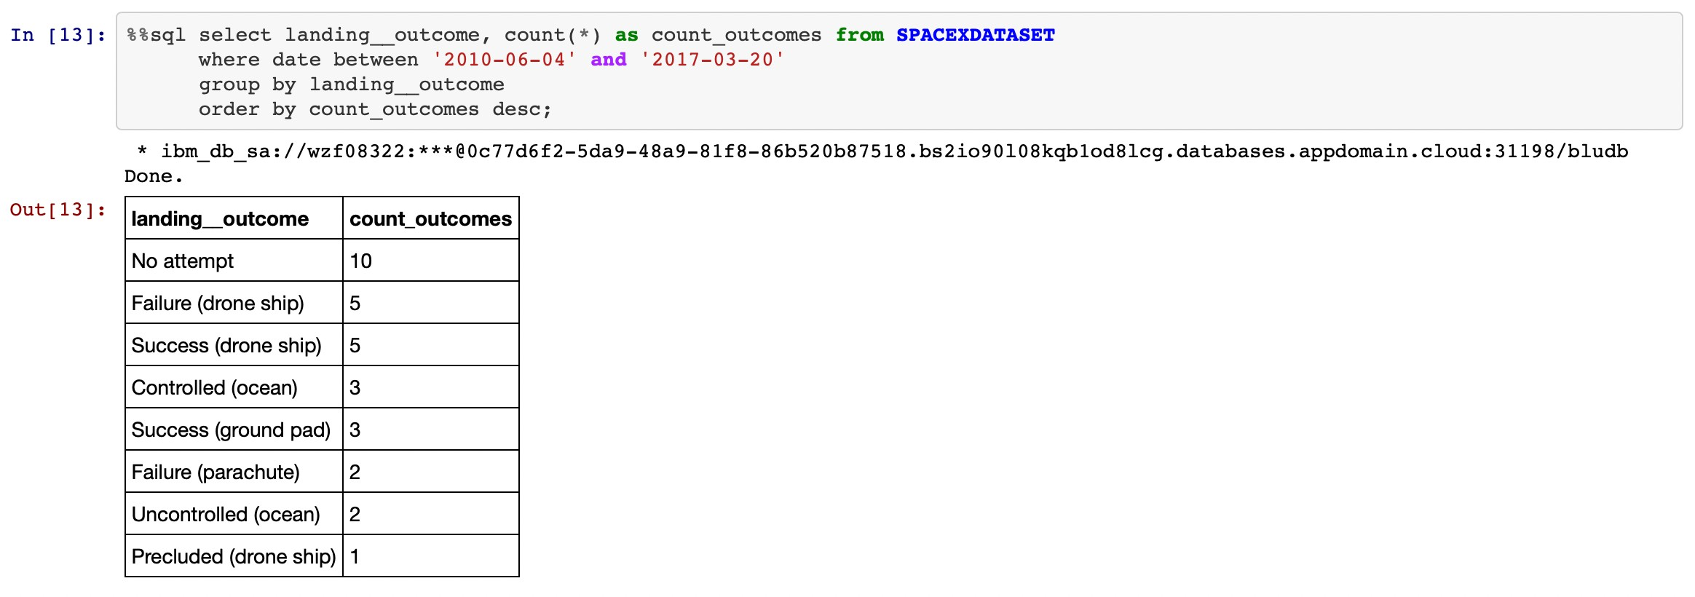
EDA with SQL (Rank success count between 2010-06-04 and 2017-03-20)
Ranking the count of landing outcomes (e.g., failure (drone ship) or success (ground pad) between the dates 2010-06-04 and 2017-03-20 in descending order.

Slide 33
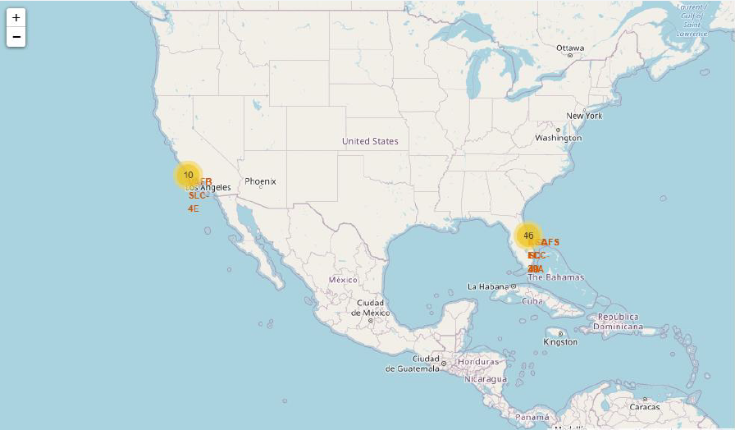
Interactive map with Folium (All launch sites’ location markers on a global map)
• The majority of launch sites are situated near the Equator line, where the Earth's surface is moving at a higher speed, reaching 1670 km/hour. When a spacecraft is launched from the equator, it inherits this existing speed, aiding in achieving and maintaining the necessary velocity for orbital motion, thanks to the principle of inertia.
• All launch sites are strategically located in close proximity to coastlines. Launching rockets towards the ocean serves to minimize the risk of debris falling or exploding near populated areas, ensuring a safer trajectory for space-bound vehicles.

Slide 34
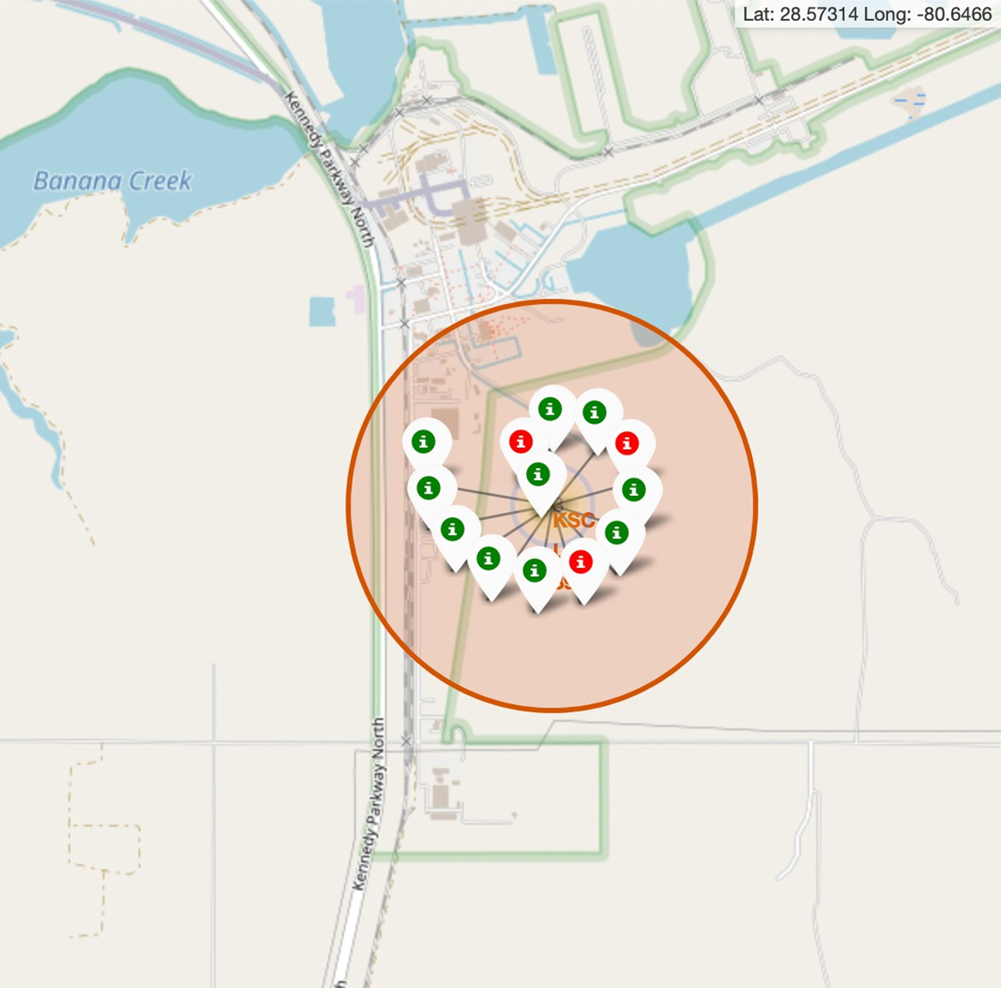
Interactive map with Folium (Color Labeled Markers)
The green marker signifies successful launches, while the red marker denotes unsuccessful launches. It is observed that KSC LC 39A exhibits a notably higher launch success rate.

Slide 35
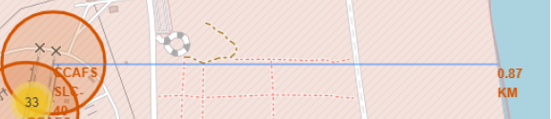
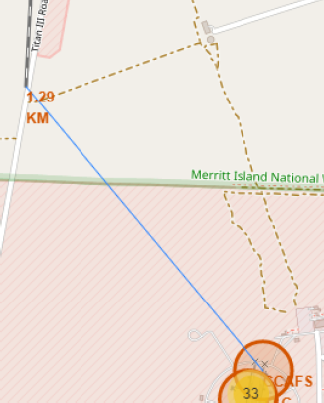
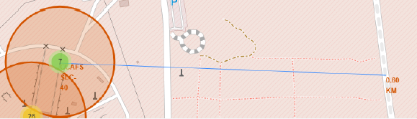
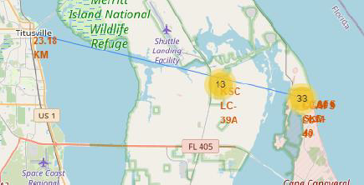
Interactive map with Folium (Distances between CCAFS SLC 40 and its proximities)
• Upon visually analyzing the launch site KSC LC-39A, it's evident that it is:
relatively close to a railway (15.23 km),
relatively close to a highway (20.28 km),
relatively close to the coastline (14.99 km).
• Additionally, the launch site KSC LC-39A is in close proximity to its nearest city, Titusville (16.32 km).
• Considering that a failed rocket, with its high speed, can cover distances of 15-20 km in a matter of seconds, there is a potential risk to populated areas.

Slide 36
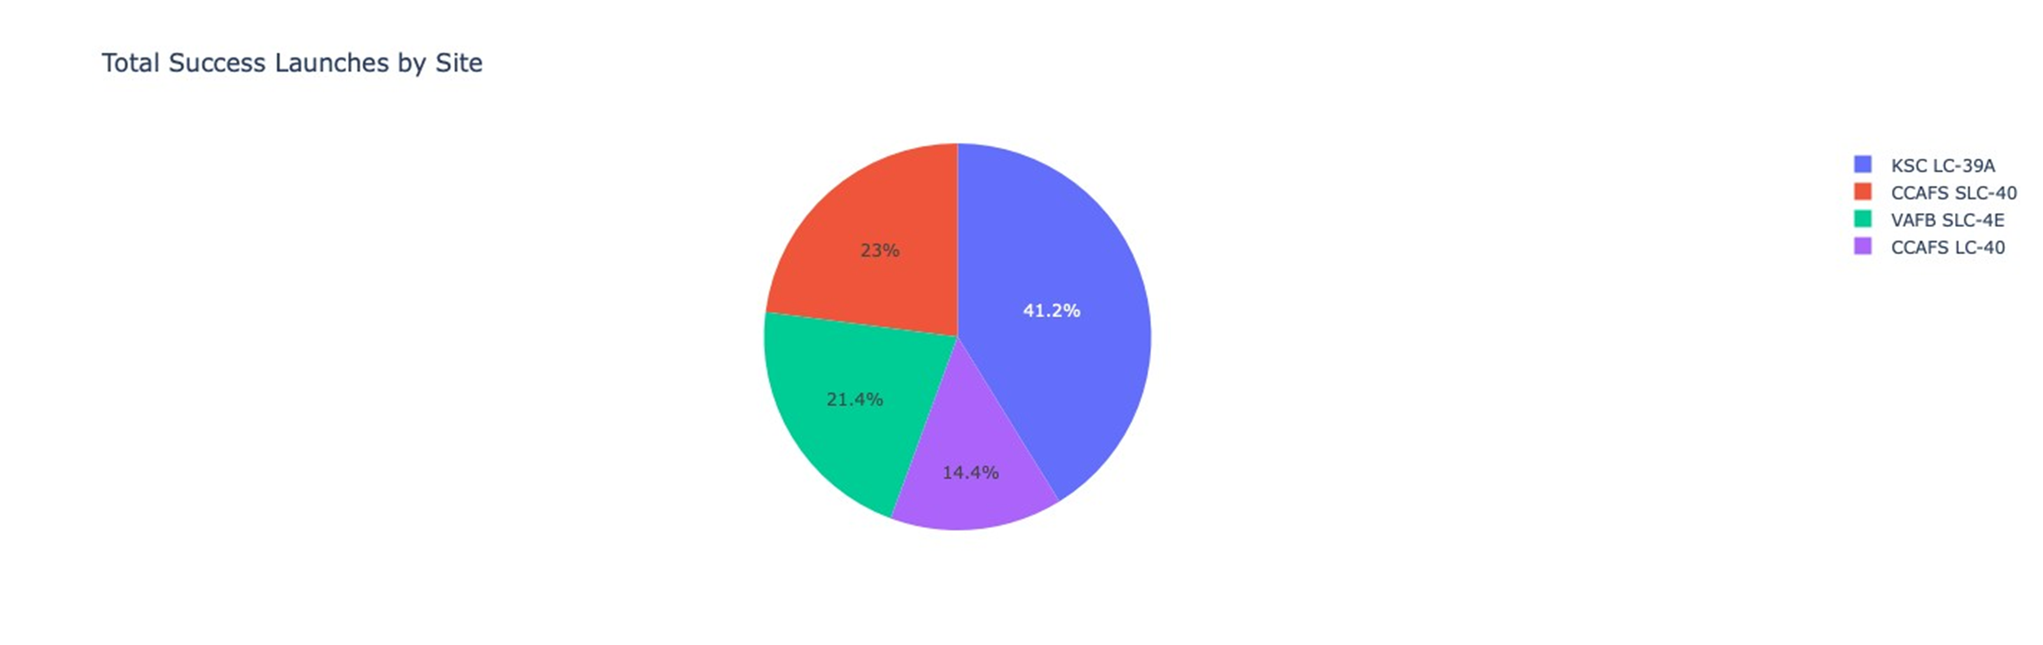
Build a Dashboard with Plotly Dash (Total success by Site)
The chart unmistakably illustrates that among all the sites, KSC LC-39A has the highest number of successful launches.

Slide 37
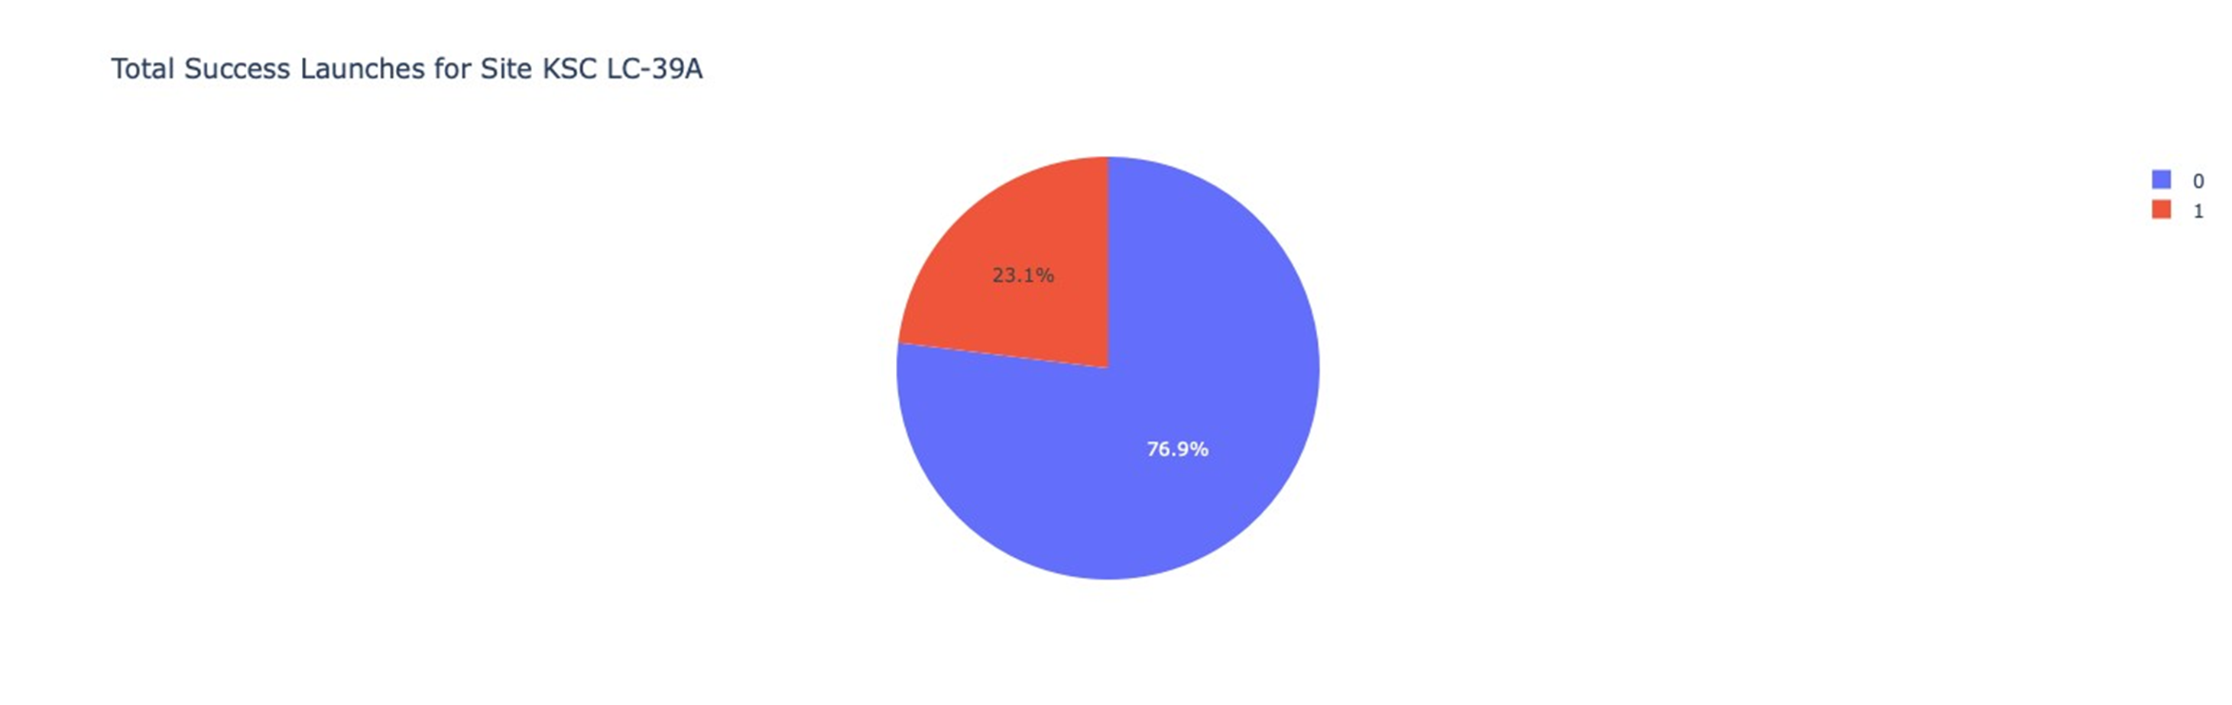
Build a Dashboard with Plotly Dash (Payload mass vs Outcome for all sites with different payload mass selected)
KSC LC-39A boasts the highest launch success rate at 76.9%, achieving 10 successful landings with only 3 instances of failure.

Slide 38
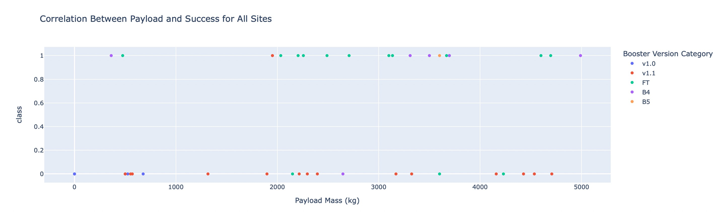
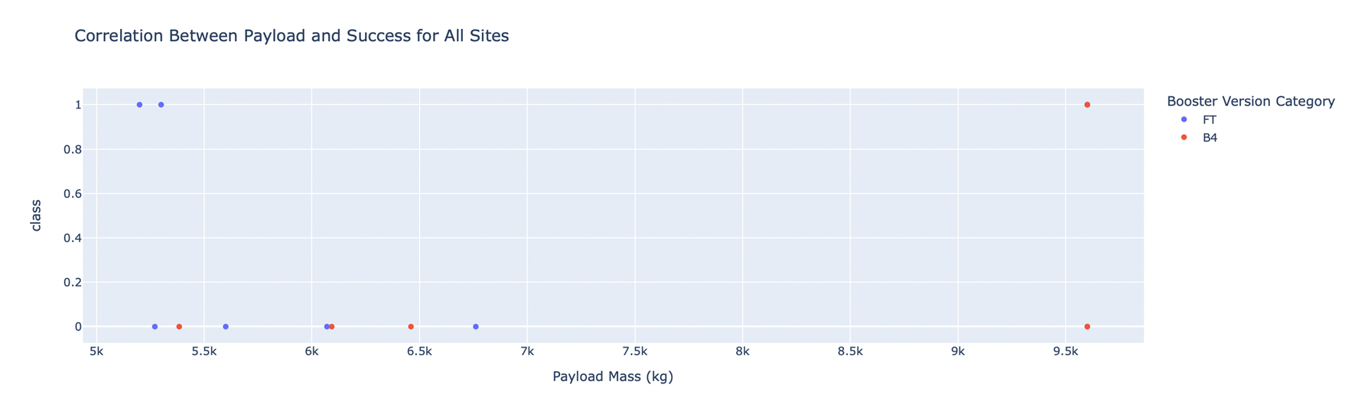
Build a Dashboard with Plotly Dash (Total success by Site)
The charts indicate that payloads ranging between 2000 and 5500 kg exhibit the highest success rate.

Slide 39
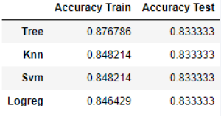
Predictive analysis – Classification (Accuracy)
Scores of the Test Set
While the Test Set scores do not provide conclusive evidence regarding the best-performing method, it's important to note that the similarity in scores may be attributed to the small sample size (18 samples). To mitigate this, we conducted tests on the entire dataset. The overall dataset scores affirm that the Decision Tree Model stands out as the best model, not only exhibiting higher scores but also achieving the highest accuracy.

Slide 40
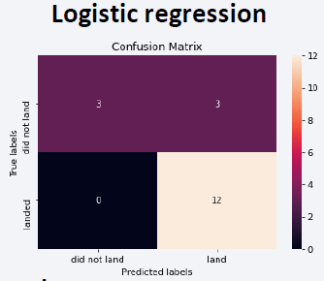
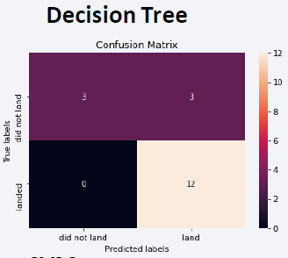
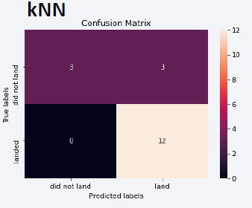

Predictive analysis – Classification (Confusion Matrix)
Given that the test accuracies are identical, the confusion matrices also exhibit uniformity. The primary issue with these models appears to be false positives.

Slide 41
Conclusions
The Decision Tree Model proves to be the most effective algorithm for this dataset.
Launches with lower payload masses tend to yield better results compared to larger payload launches.
Most launch sites are located in close proximity to the Equator line, and all sites are in very close proximity to the coast.
The success rate of launches demonstrates an increasing trend over the years.
KSC LC-39A exhibits the highest success rate among all launch sites.

Slide 42
Thank you for your time

